Slide 1
Mechanical Workshop
FIRST
Mid Atlantic Region
January 2016

Slide 2
About Us
Mechanical Workshop
Megan Flynn
Junior at Somerville High School
Team 102
Mechanical Lead and President
Doug Evans
Freshman at Rowan University
Team 102 alumni
Former Mechanical Sub lead

Slide 3
Robot Humor
Mechanical Workshop
What did the operator say when his robot died?
(ready for the answer…..)

Slide 4
RUST IN PEACE !
Notes:
Hopefully, with solid engineering designs and some luck, your robots will not suffer the same fate

Slide 5
Topics
Mechanical Workshop
Design Process/ Build
Components
Safety
Lessons Learned
Passing Mechanical Inspection

Slide 6
Design Process
Mechanical Workshop
Engineering Design
The creation of plans for machines, structures, or processes to perform desired function (within a given time constraint)
Concept Development
Brain Storming
No bad ideas
Mentors guide team through the process
Mentors address issues
Notes:
Students asked me to define engineering design
A design needs to start from a concept

Slide 7
Design Process (cont.)
Mechanical Workshop
Design Approaches
Detail Design (CAD, 3D Model)
Requires programming knowledge
More up front time (may save time during build)
Hand Drawings
Requires drafting knowledge
Should be to scale
Simple models can help
Notes:
Hand Drawings – Stress making a scaled model out of cardboard, pop cycle sticks, etc. Should have movement

Slide 8
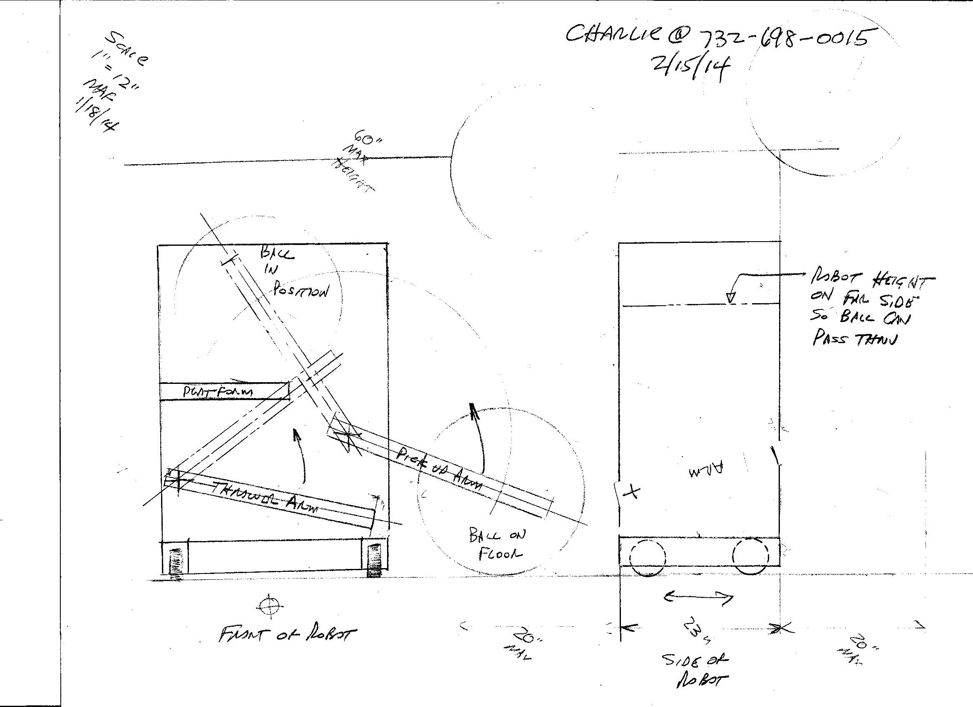
Sample Drawing
Mechanical Workshop
Notes:
I build a cardboard model based on a tennis ball, to determine how to pick up the ball and possible shot it

Slide 9
Design Process (cont.)
Mechanical Workshop
Design Approaches (cont.)
“Seat of your pants”
Just go at it
See what works
Build
Build a prototype
Use simple materials (like wood), then permanent materials
Test, make changes, retest

Slide 10
Motors (DC)
Mechanical Workshop
The torque generated by the motor and its speed or rotation are dependent on each other
This is a basic characteristic, it is a linear relationship
The motor will not operate at its no load speed, the required torque will determine the speed

Slide 11
Motors (cont.)
Mechanical Workshop
Motor Example
CIM Model FR801-001 Performance, 12V
No Load RPM = 5310 (+/- 10%)
Free Load Current = 2.7 Amps
Max Power = 337 Watts (at 2655 RPM, 172 oz-in)
Stall Torque = 343.4 oz-in
Stall Current = 133 Amps
Using this and other data, spreadsheet/curves can be generated
Notes:
Information obtained directly from the AndyMark website
The other data was from the drawing on the AndyMark website

Slide 12
Motors (cont.)
Mechanical Workshop
Speed vs. Torque Curve

Slide 13
Motors (cont.)
Mechanical Workshop
Performance Data
Condition | Torque Oz-in | Speed RPM | Current Amps | Power Out Watts | Efficiency %
No Load | 0 | 5310 | 2.7 | 0 | 0
@ Max Eff | 45 | 4614 | 19.8 | 154 | 65
Normal Load | 64 | 4320 | 27.0 | 205 | 63
 | 100 | 3764 | 40.5 | 279 | 57
@ Max Power | 171.7 | 2655 | 67.9 | 337 | 41
 | 200 | 2218 | 79.0 | 328 | 35
 | 300 | 671 | 117.0 | 149 | 11
@ Stall | 343.4 | 0 | 133.0 | 0 | 0
Note efficiency increase and decrease
Notes:
Data at 100, 200 and 300 oz-in:
Speed obtained from speed/torque plot
Current obtained from torque/current plot
Power Out (Watts) = Torque x Speed x 0.00074
Example at Max Eff.
45 x 4614 x 0.00074 = 153.6 or 154 watts
Efficiency = Power out/Power In
Example, at Max Eff.
19.8 amps x 12 volts = 237.6 watts
(154/237.6)x100 = 65%

Slide 14
Motors (cont.)
Mechanical Workshop
Useful Motor Information
Power (Watts) = Torque (oz-in) * Speed (RPM) * 0.00074
Variation, Input Voltage
Speed and Torque increase or decrease by the same percentage as the variation in supply voltage
Output power increases or decreases by the following:
(1 + speed change %)²
Efficiency is power out divided by power in
Maximum power is at 50% of no load speed

Slide 15
Gear Boxes
Mechanical Workshop
Gear sets enclosed in a housing
Various gear ratios available
Ratio is determined by the number of teeth on each gear
Ratio = # Teeth Given Gear/ # Teeth Drive Gear
Used to reduce speed and increase torque
Speed decrease based on the ratio
Torque increases based on the ratio
Notes:
Gear sets enclosed in a housing
Various gear ratios available
Ratio is determined by the number of teeth on each gear
Ratio = # Teeth Given Gear/ # Teeth Drive Gear
Used to reduce speed and increase torque
Speed decrease based on the ratio
Torque increases based on the ratio

Slide 16
Gear Boxes (cont.)
Mechanical Workshop
Gear Boxes (cont)
Most common is spur gear type
Can install more than one motor
More output power
Increased output speed (for given torque)
Approximately 95% efficiency (per gear set)
Units are heavy, mount low in robot
Can be back driven on output shaft

Slide 17
Sprockets and Chains
Mechanical Workshop
Sprockets and Chains
Chain Size | Pitch | Average Ultimate Strength
#25 | 1/4” | 875 lb
#35 | 3/8” | 2100 lb
Note – Need to apply a safety factor, at least 1.5 or 2, to the average ultimate strength to obtain working strength

Slide 18
Sprockets and Chains (cont.)
Mechanical Workshop
Center distance
Minimum 30 times the pitch
Generally 50 times the pitch
Maximum 80 times the pitch
Provide center distance adjustment
Permissible chain speed (lubricated)
#25 – 500 FPM
#35 – 370 FPM
Wrap angle – approximately 120 degrees
Ratios – up to 3:1 (max of 5:1 for lower speed)

Slide 19
Pneumatics
Mechanical Workshop
Cylinders
Force = Pressure * Area
Return stroke force is less (since area is less)
Speed is controlled on the exhaust
Generally used for two position moves
Compressor used to compress atmospheric air pressure to elevated pressure
Regulator used to reduce operation pressure (storage pressure is higher)
Accumulators used to store air volume at elevated pressures

Slide 20
Wheels
Mechanical Workshop
Basic
Forward and backward motion
Driven by one motor or multiple wheels connected to one motor
Mecanum
Forward, backward, and side-strafing
One motor per wheel

Slide 21
SAFETY
Mechanical Workshop
SAFETY
Wear your safety glasses when:
Operating tools and machines
Assembling robot
Testing and operating robot
At competition
Operating machinery
Read all instructions
If you don’t know/understand, ASK
THINK and BE SAFE

Slide 22
Robot
Mechanical Workshop

Slide 23
Passing Mechanical Inspection
Mechanical Workshop
Meet rulebook requirements
Weight
Dimensions
Bumpers
Pressure requirements
No sharp edges

Slide 24
Lessons Learned
Mechanical Workshop
Read and understand the rules
Low center of gravity
Stronger
Faster
Voltage regulator
Layer design
Flexible shafts
Side drive wheels
Check lists
Know your strengths and sell them
Ability to measure distance
Tool belt with important tools

